Slide 1
Activity & State Chart Diagram

Slide 2
Activity Diagrams
An activity diagram
Can be used to understand the flow of work that an object or component performs.
Is most often associated with several classes.
One of the strengths of activity diagrams is the representation of concurrent activities.

Slide 3
Activity Diagram
Activity diagrams provide a way to model the workflow of a business process.
Activity diagrams are very similar to a flowchart because you can model a workflow from activity to activity.

Slide 4
Activity Diagram
An activity diagram is typically used for modeling the sequence of activities in a process,
A state chart is better suited to model the discrete stages of an object’s lifetime.
Activity diagrams are used to show workflow in parallel and conditionally.

Slide 5
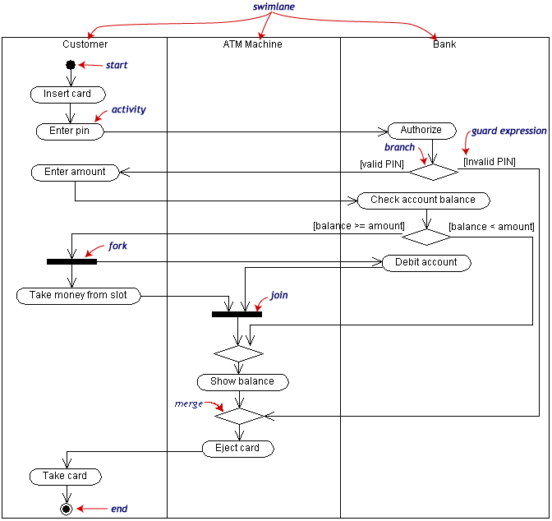
Withdraw money from a bank account through an ATM

Slide 6
Activity Diagram to Operate Light

Slide 7
Activity Diagram to Issue Book

Slide 8
Activity Diagram to Return Book

Slide 9
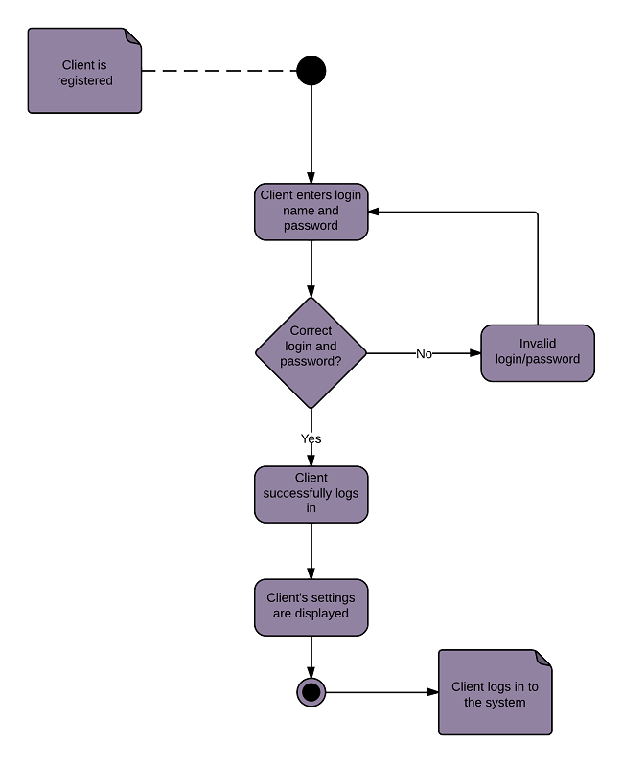
Activity Diagram for
Login Process

Slide 10
State Diagrams
A state diagram describes the behaviour of an individual object with the system.
At any given point in time, object is in a certain state.
Being in a state means that it is will behave in a specific way in response to any events that occur.
Some events will cause the system to change state.
A state diagram is a directed graph where the nodes are states and the arcs are transitions.

Slide 11
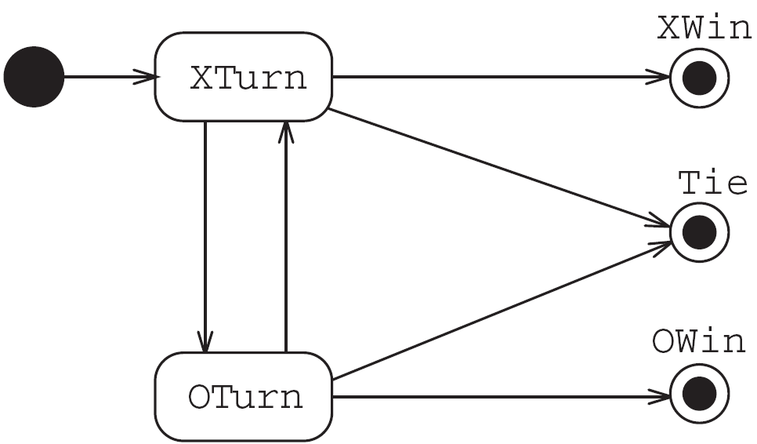
State diagrams – an example
tic-tac-toe game (also called noughts and crosses)

Slide 12
State Chart Diagram
Each state represents a named condition during the life of an object during which it satisfies some condition or waits for some event.
A state chart diagram typically contains one start state and multiple end states.
A state chart diagram is typically used to model the discrete stages of an object’s lifetime.

Slide 13
State Chart Diagram
State Transition
A state transition indicates that an object in the source state will perform certain specified actions and enter the destination state when a specified event occurs or when certain conditions are satisfied.
You can show one or more state transitions from a state as long as each transition is unique.

Slide 14
State Chart Diagram
The state icon appears as a rectangle with rounded corners and a name (eg Wait)
Start State
The start state icon is a small, filled circle that may contain a name (Begin Process)
Only one start state

Slide 15
State Chart Diagram
Only one outgoing transition can be placed from the start state.
Multiple transitions may be placed on a start state if at least one of them is labeled with a condition.
No incoming transitions are allowed.
You can label start states, if desired.

Slide 16
State Chart Diagram
End State
An end state represents a final or terminal state on state chart diagram.
there can be any number of end states per context.
You can label end states, if desired.
Graphical Depiction
The end state icon is a filled circle inside a slightly larger unfilled circle that may contain a name (End Process):

Slide 17
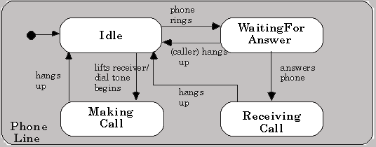
State Chart diagram for a Phone

Slide 18
State Chart Diagram: System Admin

Slide 19
State Chart Diagram: Microwave

Slide 20
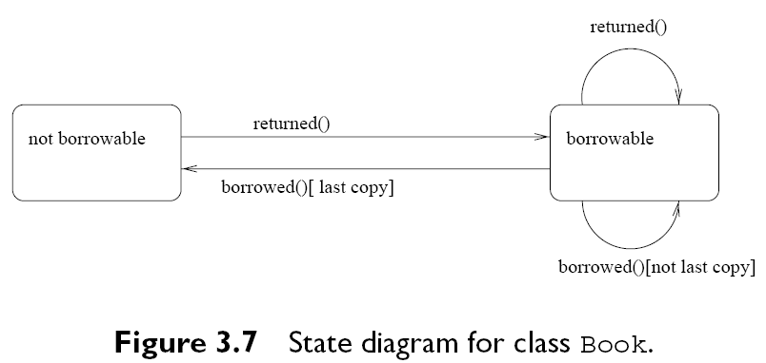

Slide 21
State Chart Diagram for
Book

Slide 22
State Models
Components
States: a condition of an object
Events: a state changing occurrence
Transitions: from one state to the next, occur when the associated event occurs

Slide 23
State Diagram for a student

Slide 24
Consistent and Complete
Multiple transitions from a state?
Non-overlapping events (consistency)
Complete set of events
Sample state machine
What if dinner time occurs at the same time as the next class time?
What happens after breakfast if there are no classes?
What happens if dinner time event occurs while in class?

Slide 25
Augmented Diagrams
Constraints/guards needed for better model
Condition(s) added to transition(s)
If event occurs, transition takes place only if condition is satisfied
Actions can be added to transitions
Performed if transition takes place
Actions on state entry and state exit also

Slide 26
Student Example 2

Slide 27
State chart diagram for Librarian

Slide 28
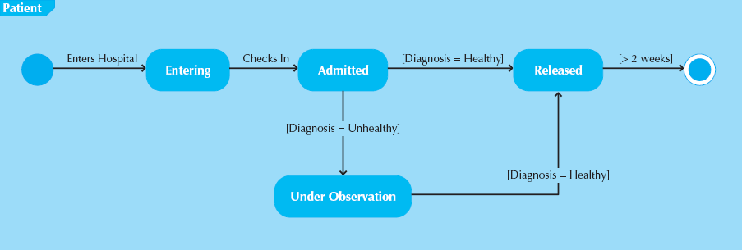
Sample State Diagram for Patient Class

Slide 29
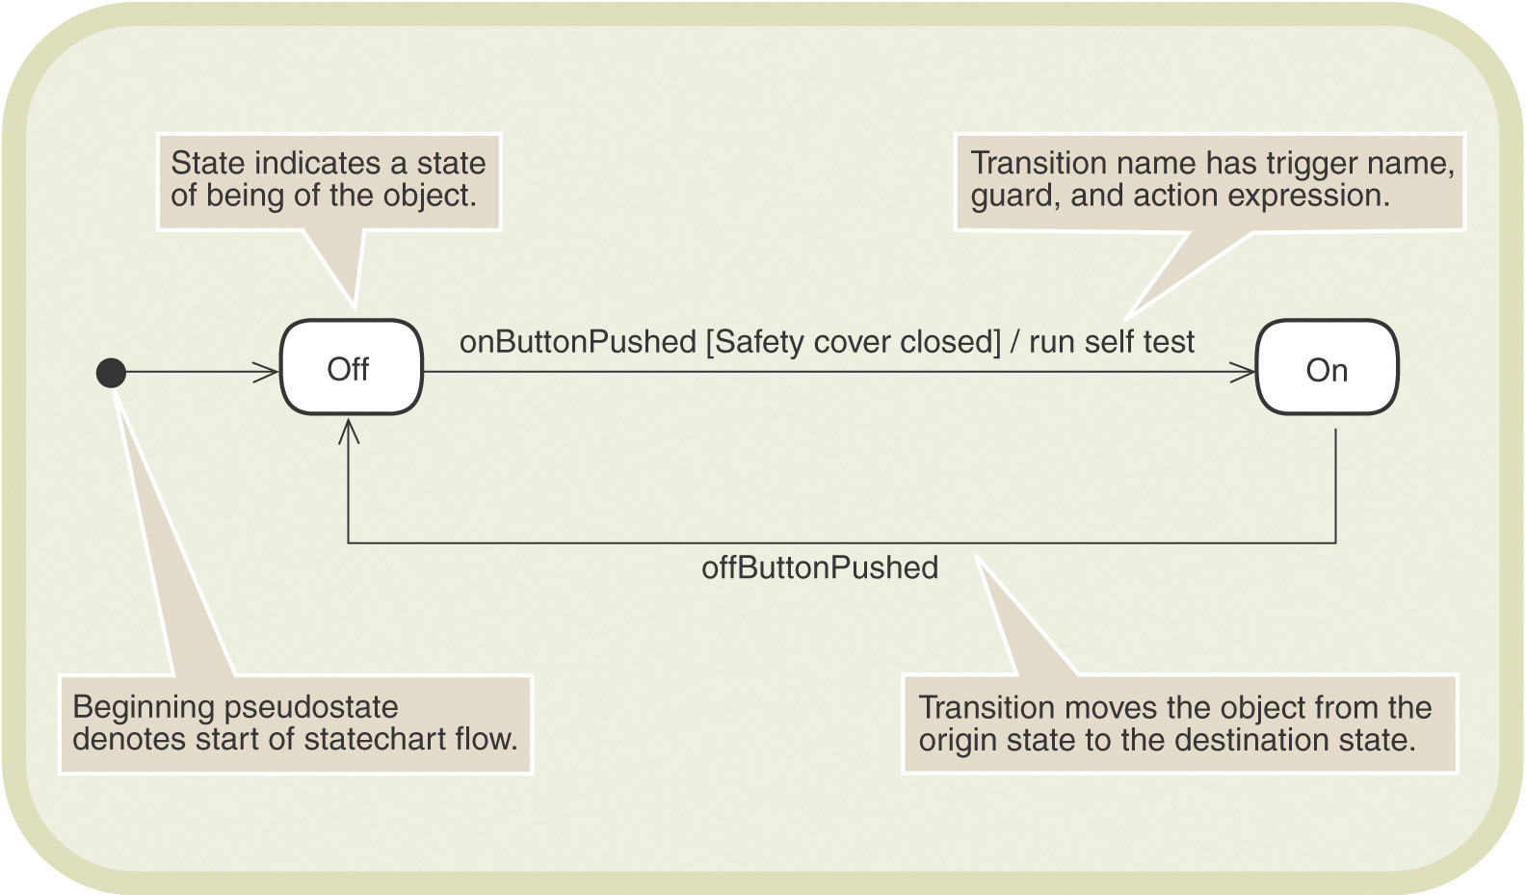
Simple Statechart for a Printer

Slide 30
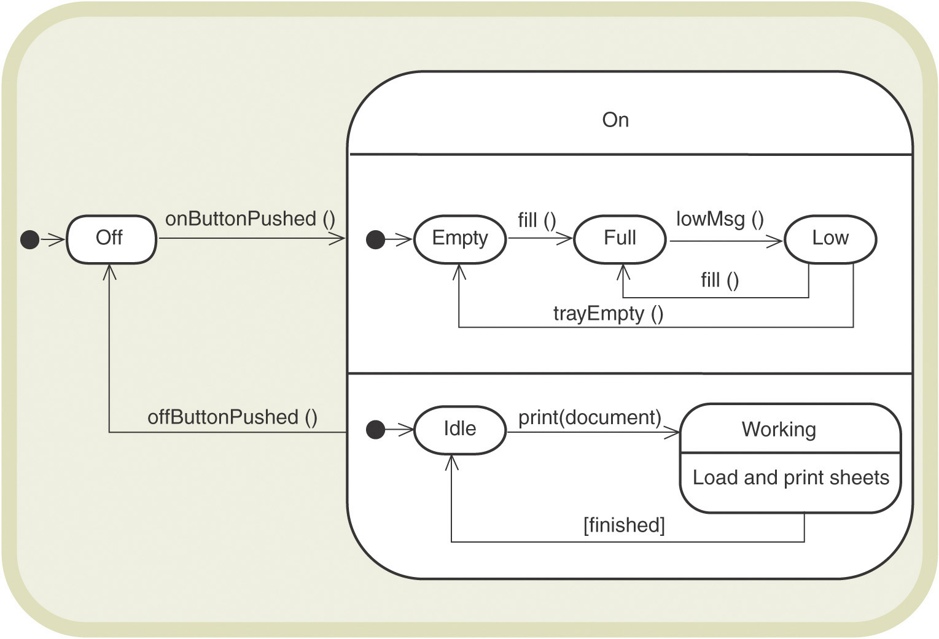
Concurrent States for a Printer in the On State

Slide 31
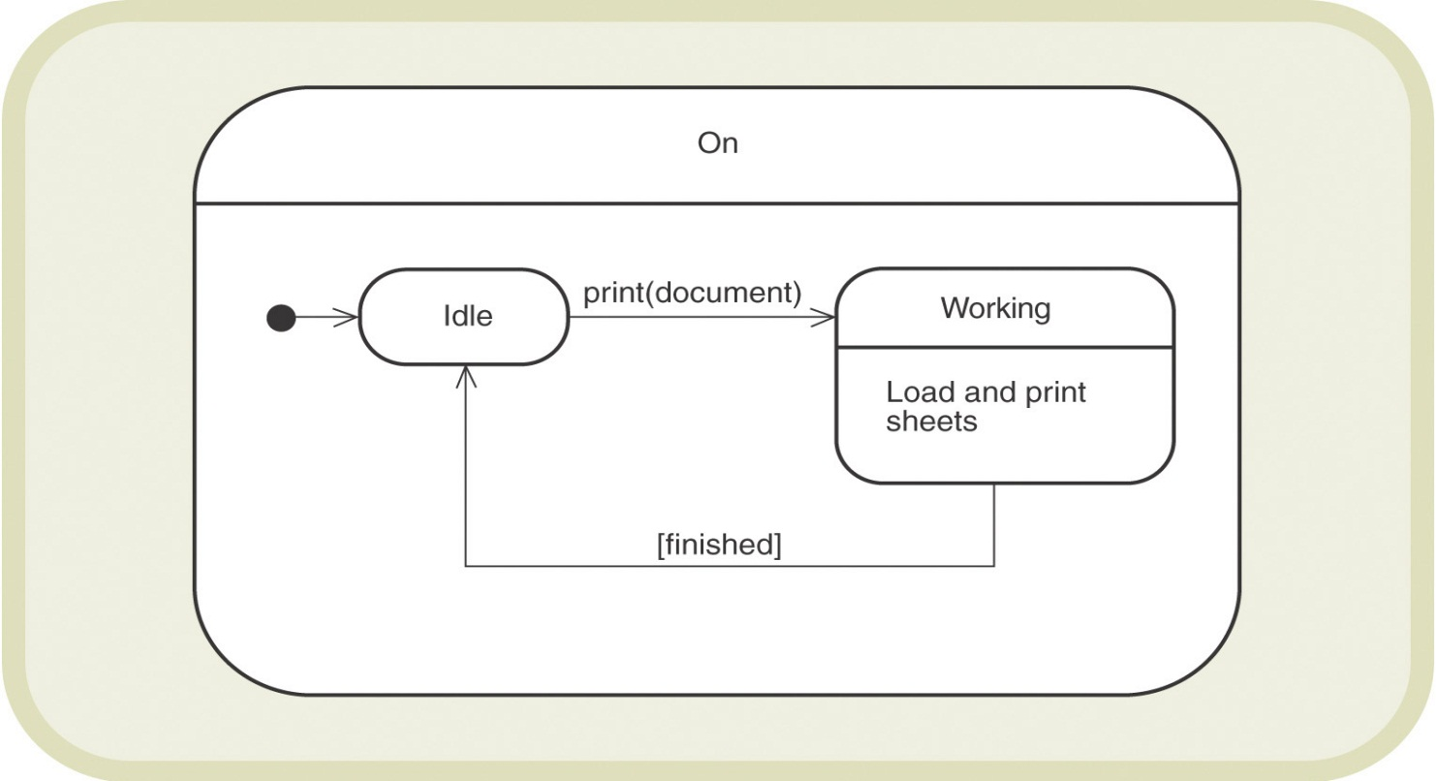
Nested States
Composite states – state containing multiple levels and transitions
Can contain nested states and transition paths

Slide 32
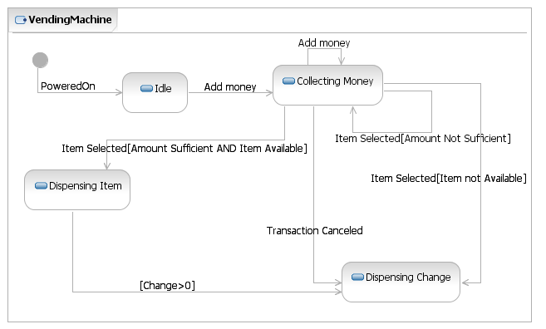
Vending Machine Example

Slide 33
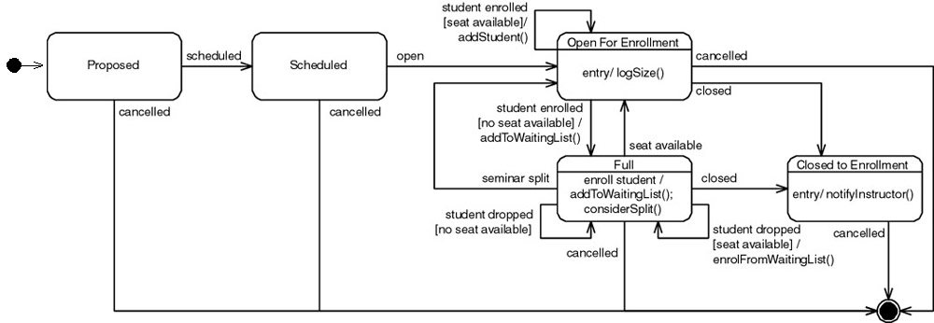
Seminar

Slide 34
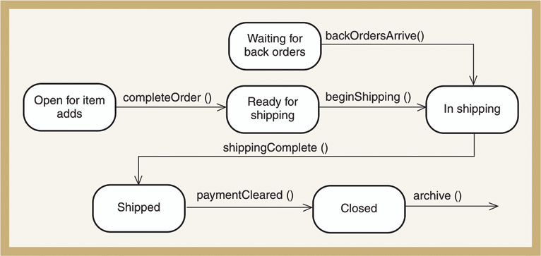
First-Cut State Machine Diagram for Order

Slide 35
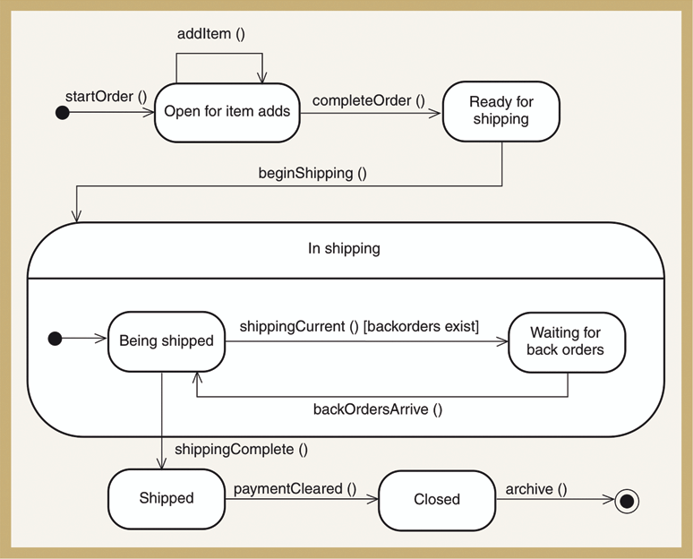
Second-Cut State Machine Diagram for Order
Figure 7-23

